Slide 1
How To Use: Cam Generator App
Creating, analyzing, and exporting a rotary cam easily and quickly
Jack Hammer
FPS/KFP

Slide 2
The Apps Purpose
This app was made to quickly iterate on rotary cam designs to then simulate performance in CREO
It allows you to..
  Create custom cam design
  View the follower motion
  Watch/create an animation of this motion in 2D
  Export the cam as points to be used in modeling software

Slide 3
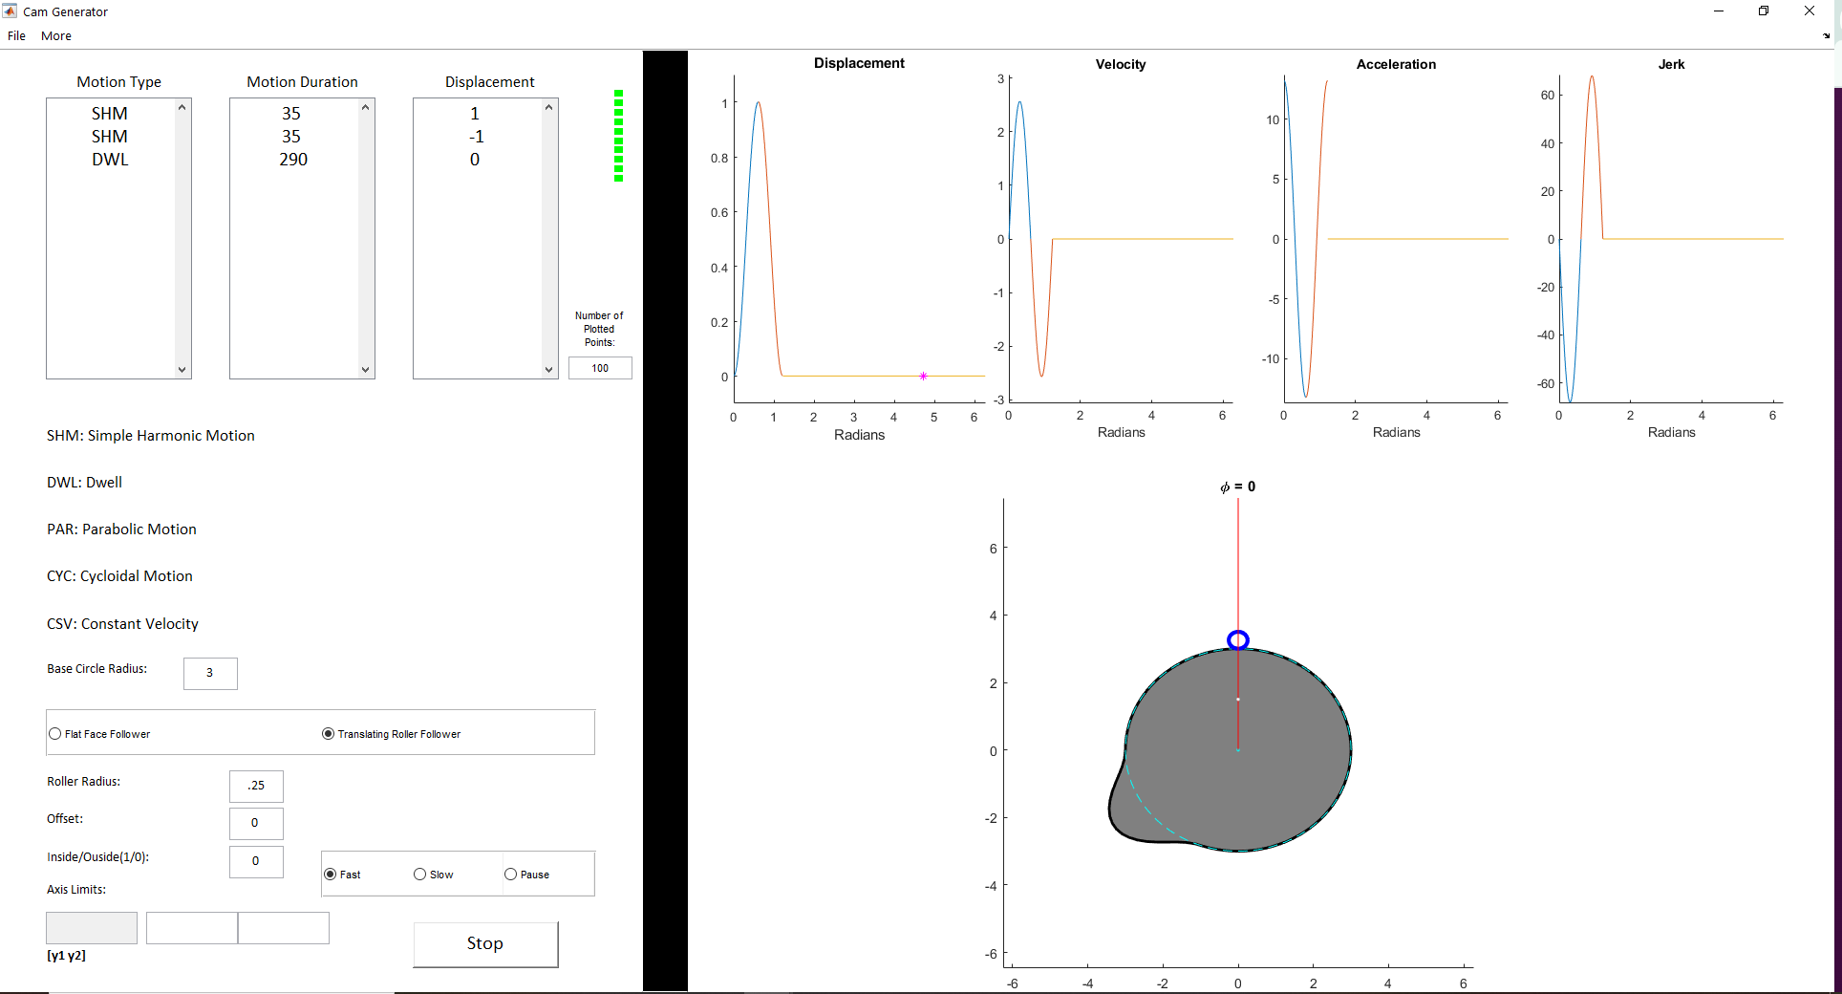
App Layout

Slide 4
App Layout
Output motion input

Slide 5
Using the App
Number of points used for cam generation

Slide 6
Using the App
Base radius

Slide 7
Using the App
Follower characteristics input

Slide 8
Using the App
Run Generator

Slide 9
Using the App
Follower motion graphs
Generated Cam animation

Slide 10
Using the App
In the “File” tab, you can save and load different profiles. There are some examples already saved in the “Models” folder

Slide 11
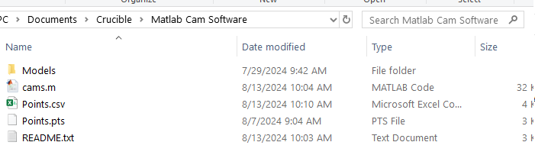
Importing into CREO
CSV file which includes the points for the cam
Open the points.csv file
Save it as a .txt file
Manually change it from a .txt file into a .pts file (remove the .txt and add .pts in file name)

Slide 12
Using the App
Follower motion graphs
Generated Cam animation

Slide 13
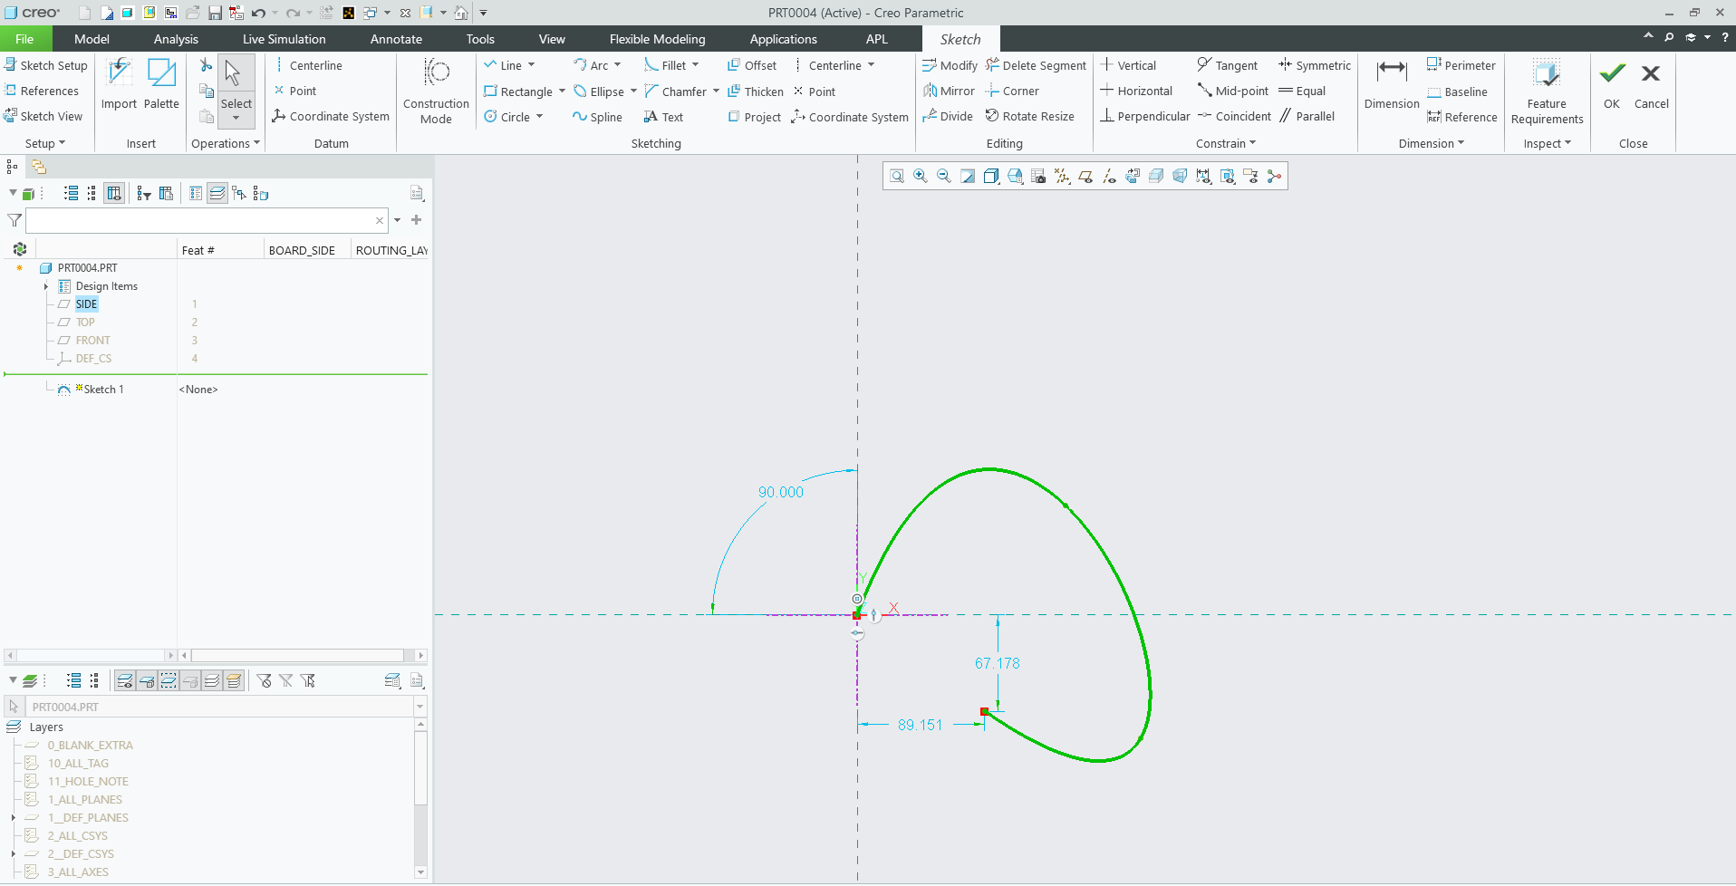
Importing into CREO
In a new sketch, place a coordinate system and an open spline with any shape

Slide 14
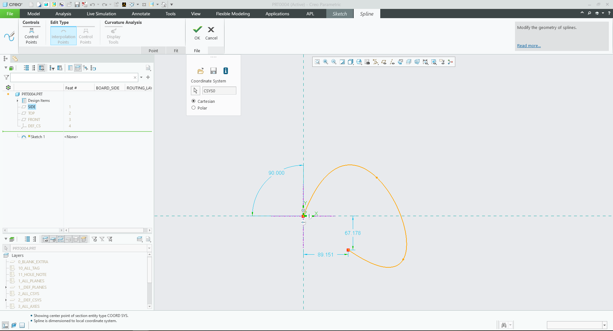
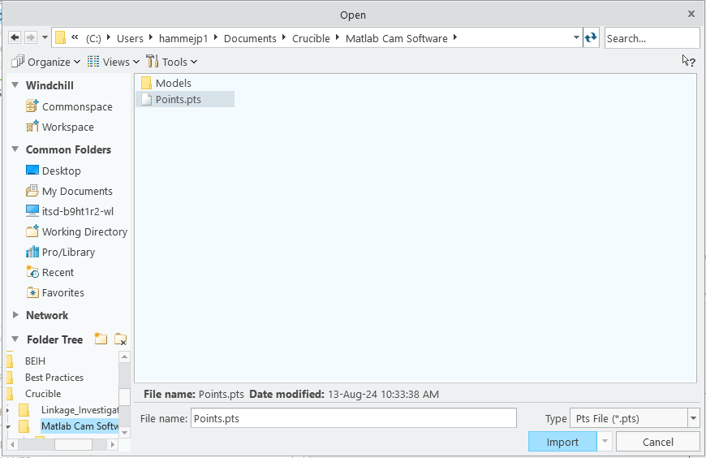
Importing into CREO
In the spline settings:
Go to the file tab
Select the coordinate system you just placed
Open the folder for the .pts file
Select the file to fit the spline to the cam points

Slide 15
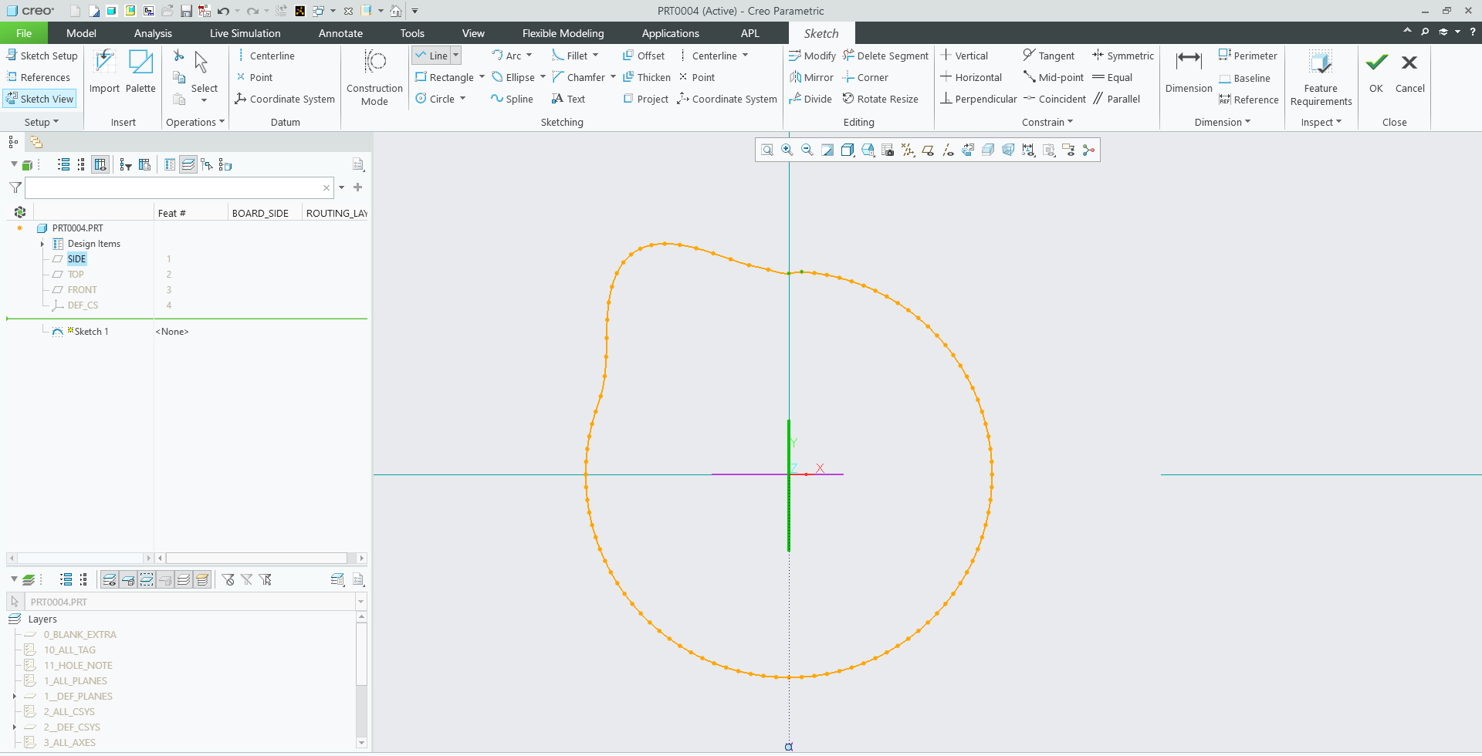
Importing into CREO
The cam is now in CREO as a spline connecting many points
Notes:
Sometimes the spline will have some artifacting and will need to be cleaned up, use the delete segment and point removal tool as necessary
The center of the coordinate system is the point at which the cam should be rotated about
The app writes over whatever is in the Points.csv file

